Slide 1
COS30045 Project Stand Up 2
Topic: Hospitalised Injuries from Road Crashes in Australia
By: Helen C

Slide 2
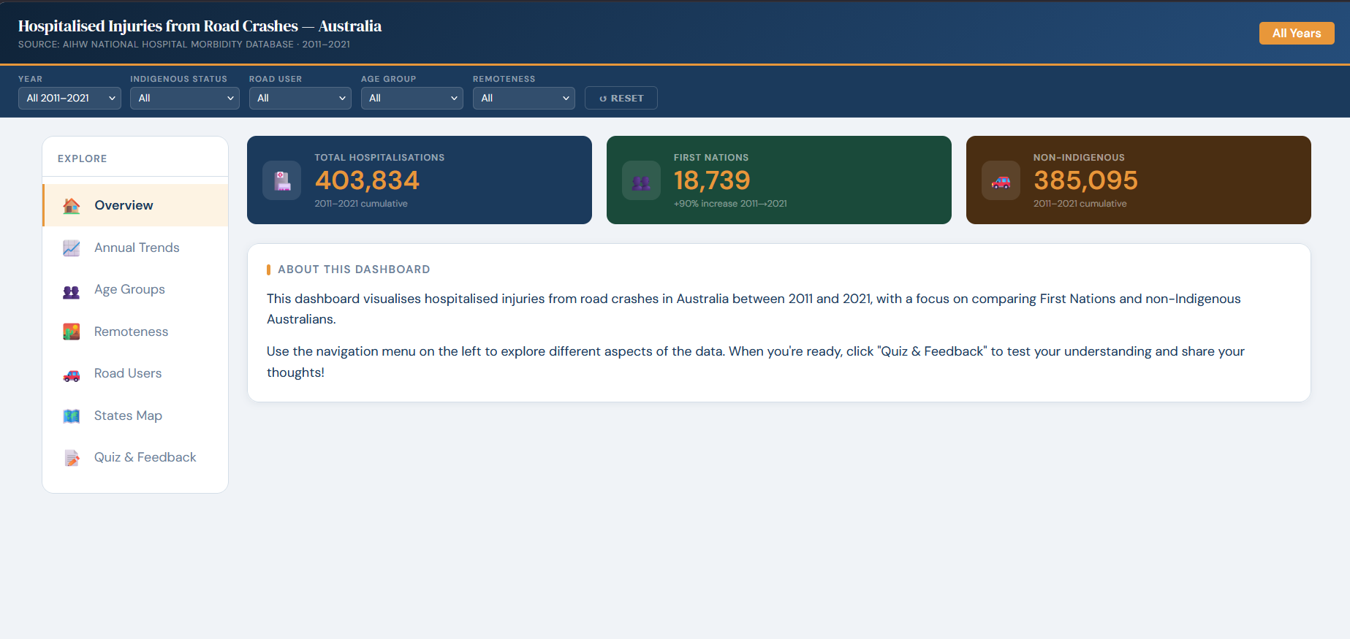
Progress Overview
What We Have Completed Since Week 12
Full interactive website built with Chart.js
7-page layout with sidebar navigation
5 chart types: line, bar, horizontal bar, pie charts, SVG maps
Interactive filters (Year, Indigenous Status, Road User, Age, Remoteness)
Quiz & Feedback feature with 3 questions
Iteration and Validation chapter written
No major blockers --- all features working

Slide 3
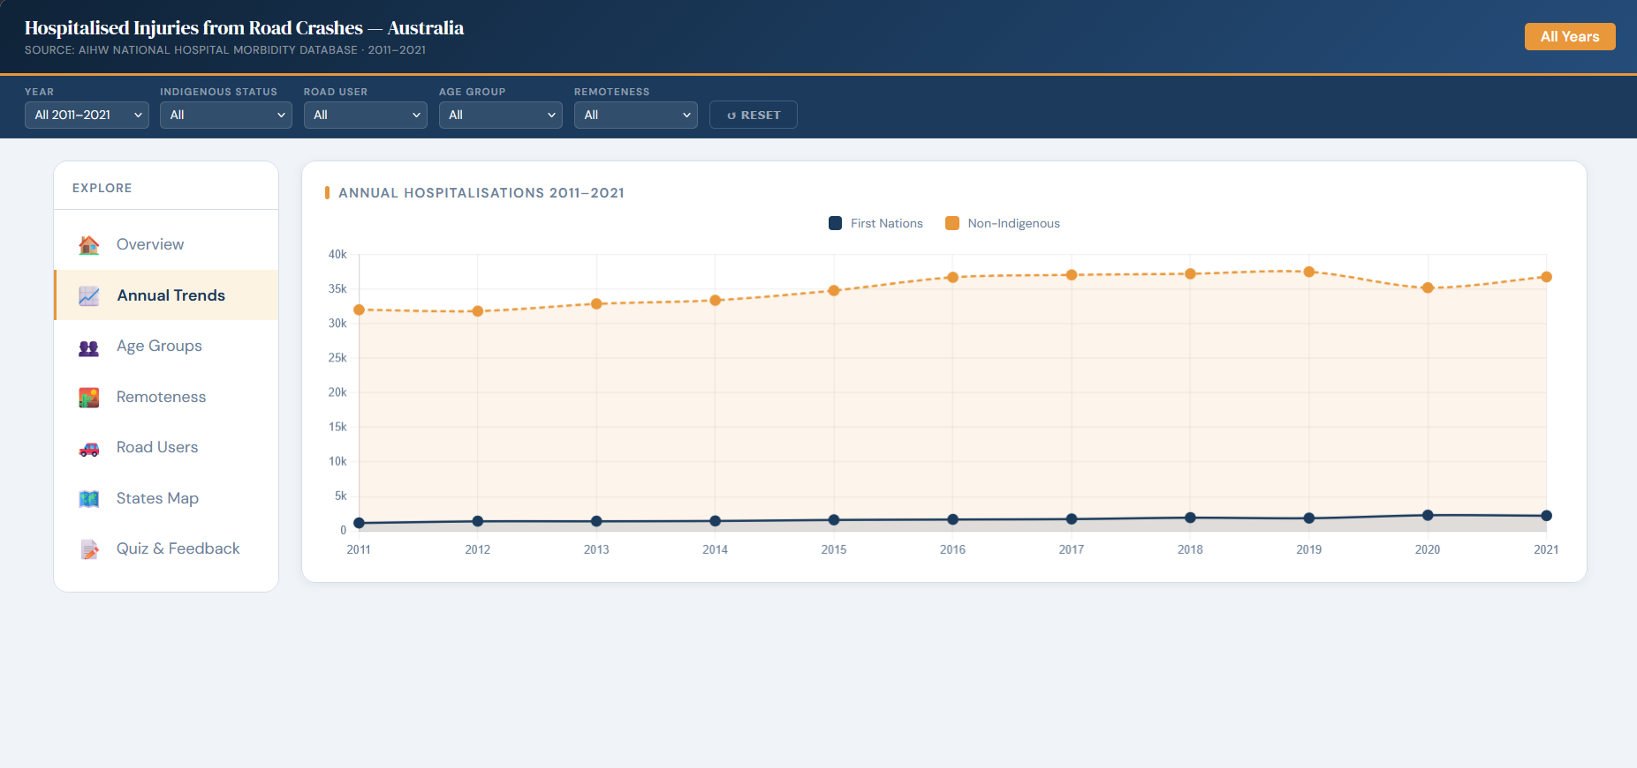
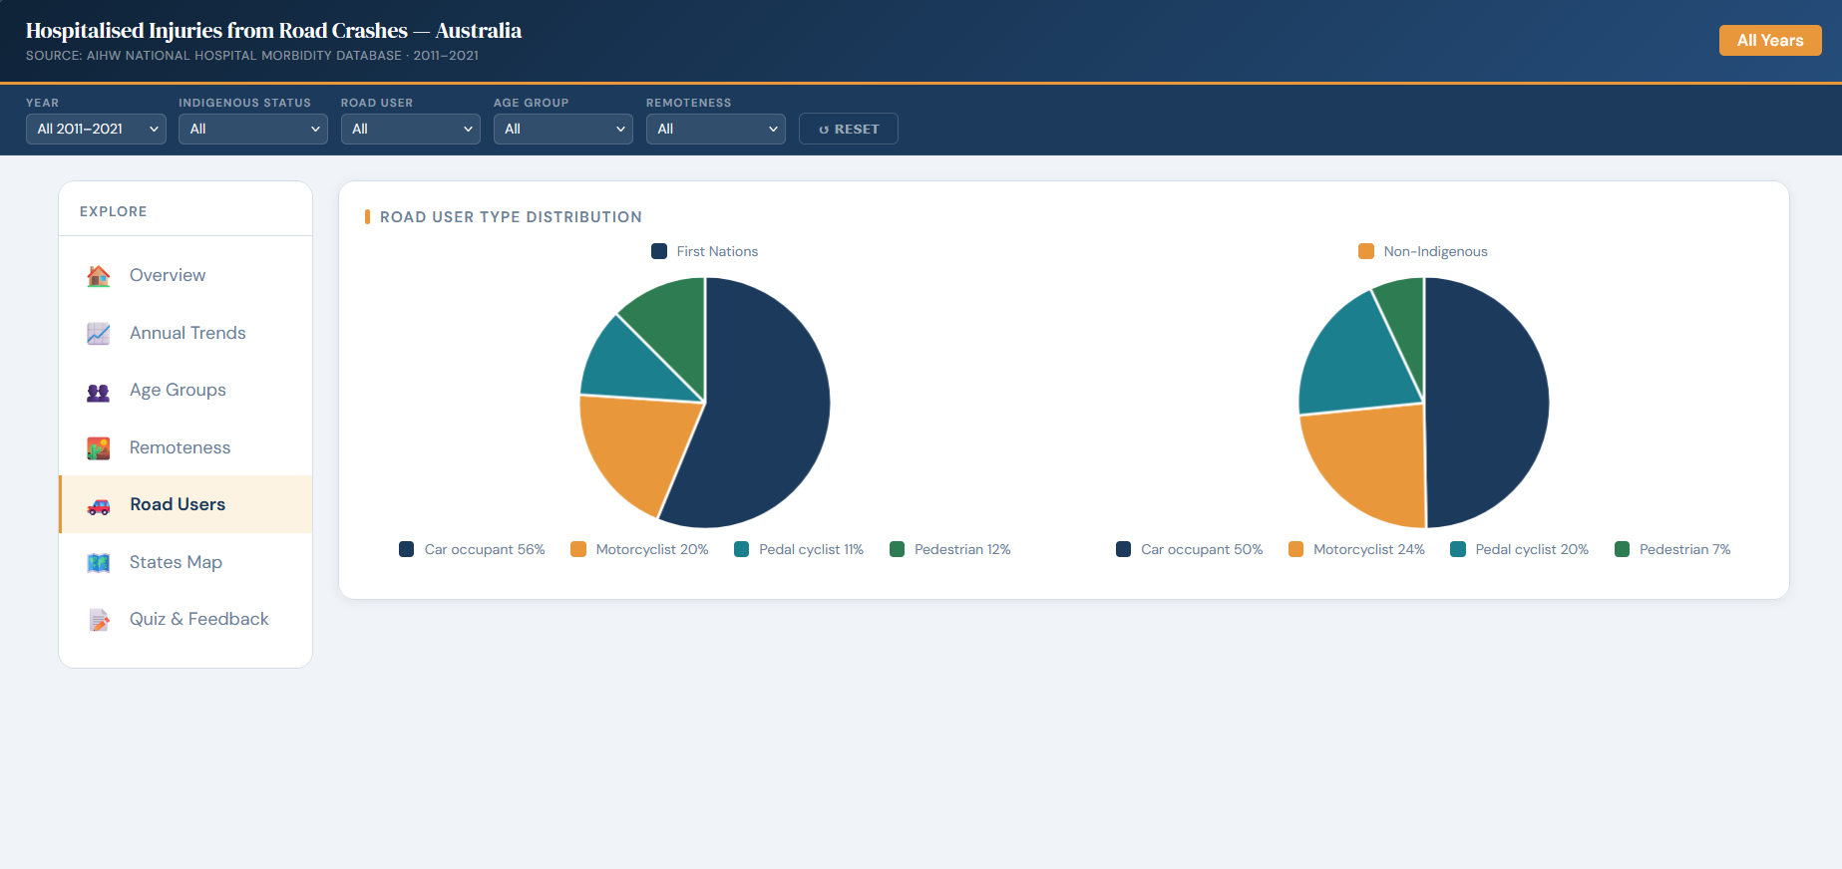
Visualisation Design
Chart Types We Actually Built
Line Chart — Annual Trends (2011–2021)
Two lines: First Nations vs non-Indigenous. Gap shows disparity.
Grouped Bar Chart — Age Groups
17-25 age group has highest First Nations count.
Horizontal Bar Chart — Remoteness
Major Cities, Regional, Remote. Regional areas have highest counts.
Pie Charts — Road User Types
Two pie charts side by side (First Nations vs non-Indigenous).
SVG Map — States and Territories
Hover for details. Click to filter all charts.
Design Choices:
Navy/amber colours (colourblind-safe)
Direct number labels on all charts (response to user feedback)

Slide 4
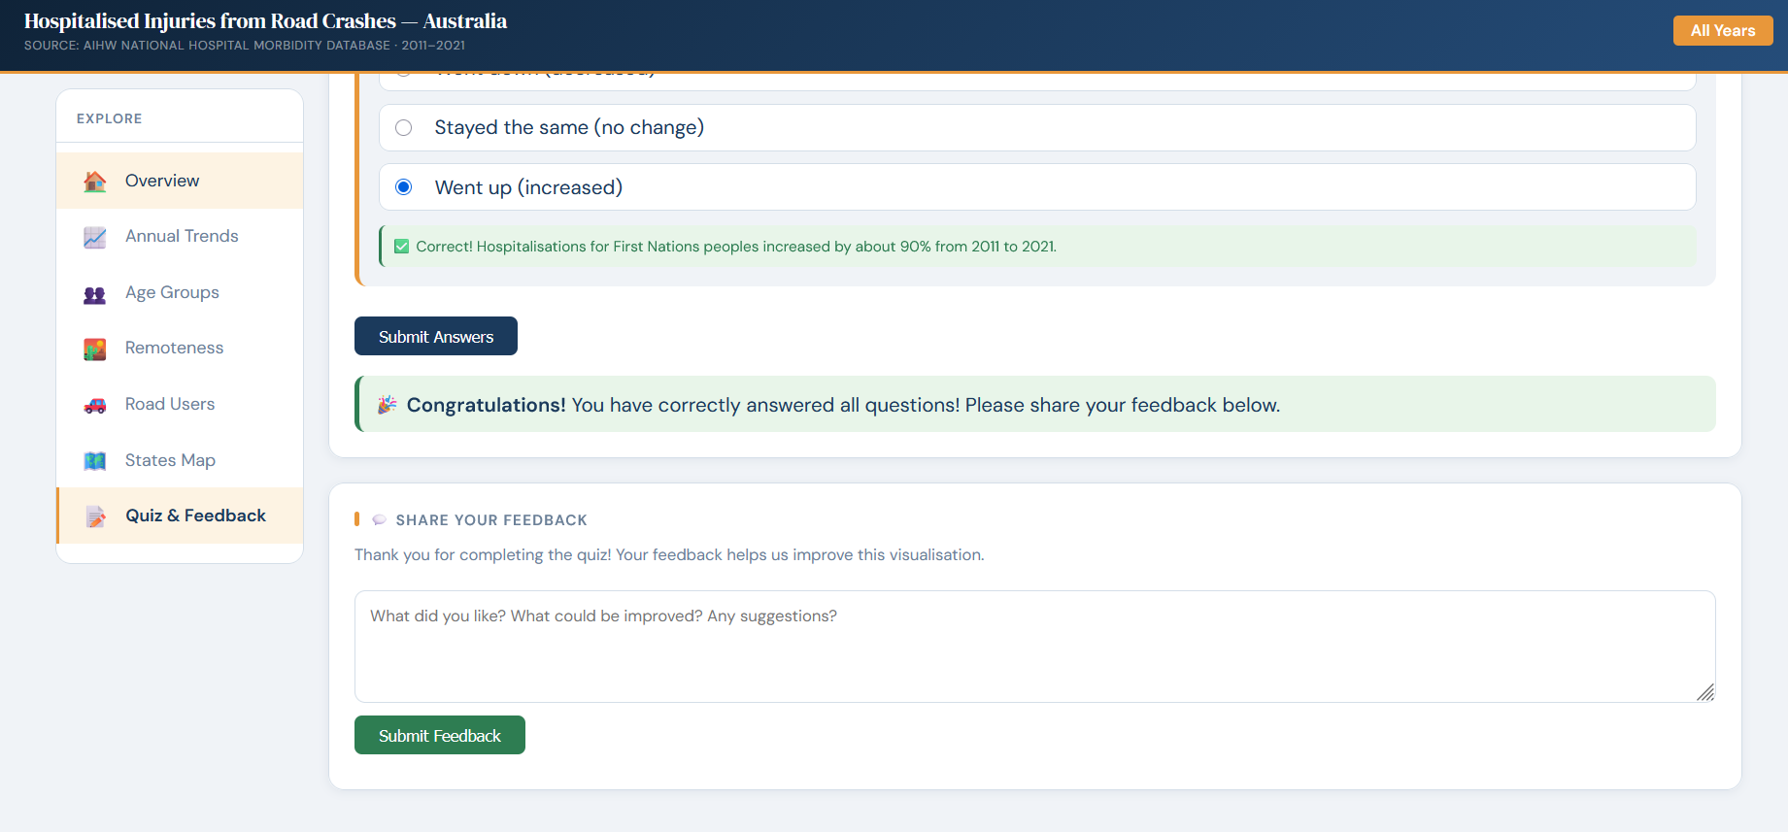
Interaction Design
What Users Can Do
1. Sidebar Navigation: 7 pages. Only one page visible at a time.
2. Filters (5 dropdowns):
Year | Indigenous Status | Road User | Age Group | Remoteness
All charts update together. Reset button clears all.
3. Interactive Map:
Hover → see state stats. Click → filter all charts to that state.
4. Quiz & Feedback:
3 questions. Instant correct/wrong feedback with hints.
All correct → feedback form appears.
5. Hover Tooltips: All charts show exact values on hover.

Slide 5
Iteration & Validation
User Testing Results:
Tested with 3 people (2 students, 1 general public)
Main Problem Found:
The page felt messy – too many charts, didn’t know where to start.
What We Changed:
Removed duplicate charts
Added direct number labels on all charts
Split content into 7 separate pages with side bar navigation
Added Quiz & Feedback feature
Results:
Task completion: 33% -> 100%
Average time: around 45s -> 25s
Limitations:
Only tested with 3 people, not tested on mobile

Slide 6
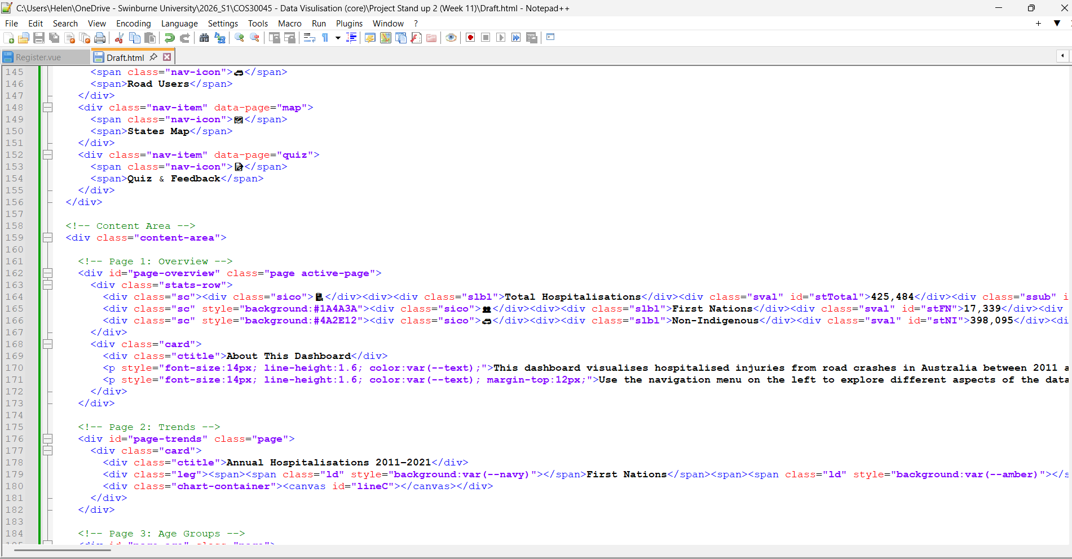
Code
I use Notepad++ as my primary code editor, for our final project, I will be using a combination of Notepad++ and Visual Studio Code.

Slide 7
Next Steps
KNIME Data Cleaning (in progress)
The data cleaning process is more complex than expected.
Multiple tables (annual, road user, age, remoteness) need to be combined.
We are continuing to refine the KNIME workflow.
Will be completed before final submission deadline.
Website refinements
Small design tweaks based on user feedback.
Ensure all charts display correctly on different screen sizes.
Design Book final edits
Proofread all sections.
Add any remaining details from usability testing.
Everything will be finished before the final project due date.

Slide 8
Thank you!

